Slide 1

A&M E-commerce Mobile APP
Graduation project

Slide 2


Supervisor
TEAM
Atef Wagdy sayed
Ahmed Mostafa Elazab
Mohamed Yasser
Eng . Marwaa Taalat

Slide 3

Agenda
1
5
Introduction
Mobile Appliction
2
6
Project idea
Back-End
3
7
Problem vs. solution
Testing
4
8
UI/UX
Conclusion/Future Scope

Slide 4

01
Introduction

Slide 5
Introduction
E-commerce has become essential in the age of technology.
Shopping apps save time and effort , making the shopping experience easier for users.
In this project, we present A&M, an e-commerce app that allows users to easily purchase various products online using the Flutter Framework.

Slide 6

02
Project idea

Slide 7
Project idea
A&M is an e-commerce app designed for users to shop for various products easily.
Key features include fast product search, adding products to favorites, a seamless checkout process, and payment through Visa.
The app also provides a personalized user experience with an easy-to-use profile section

Slide 8
03
Problem vs. solution

Slide 9

Problem vs. solution
Problem
Many users find it difficult to search for products quickly and efficiently in existing e-commerce apps .
solution
A&M offers a fast and intuitive search bar, allowing users to quickly find the products they are looking for with minimal effort

Slide 10


04
UI/UX

Slide 11
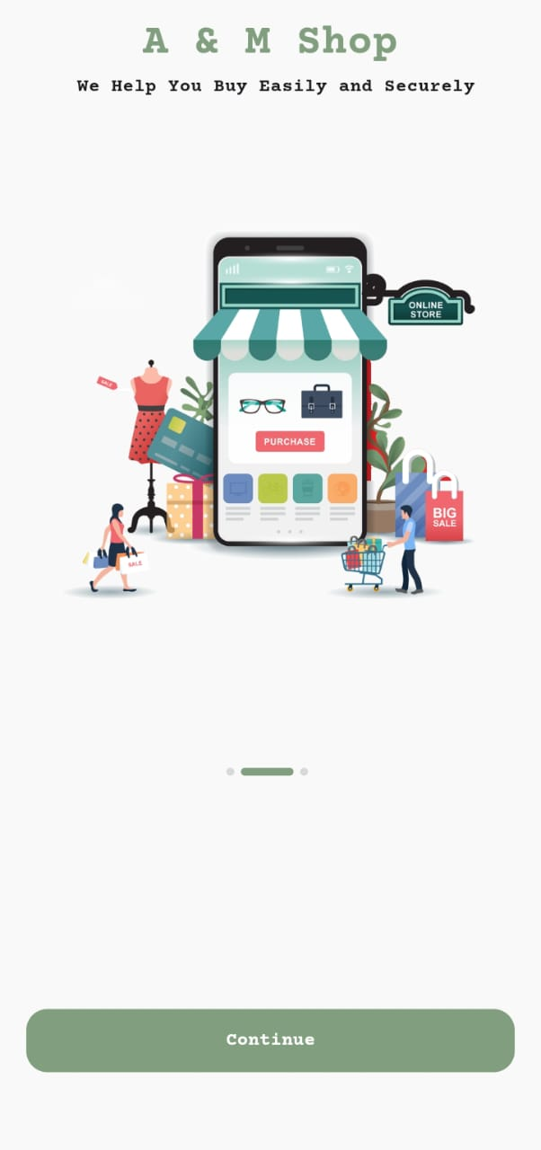
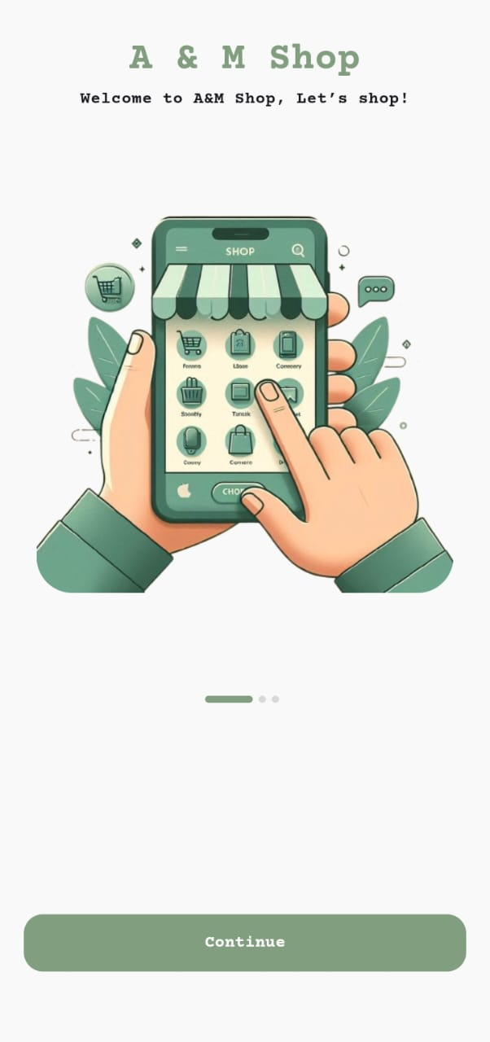
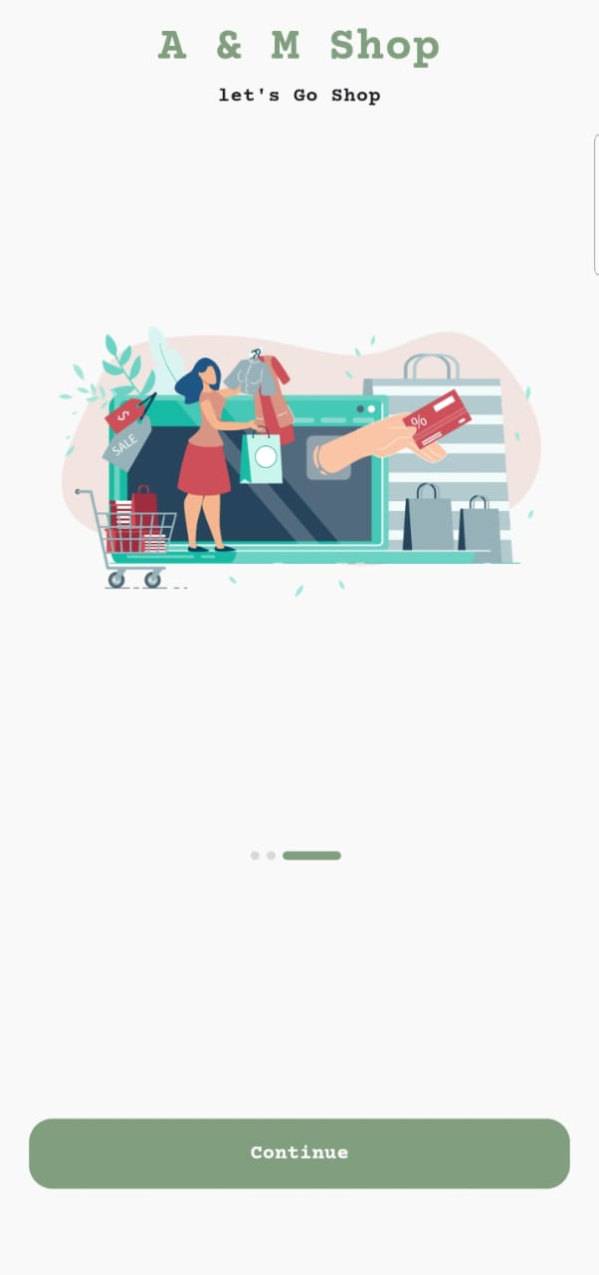

On bOn boarding screens

Slide 12
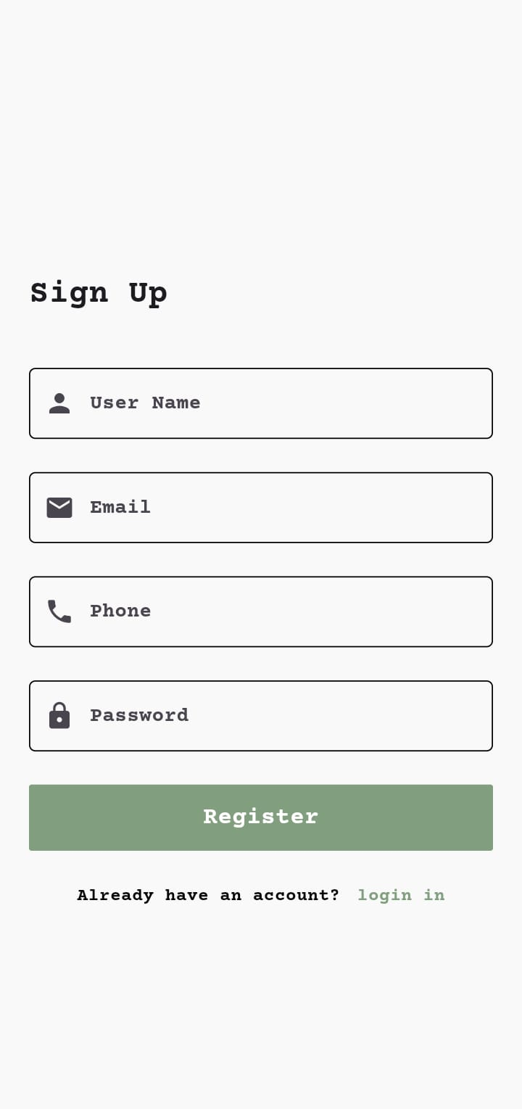
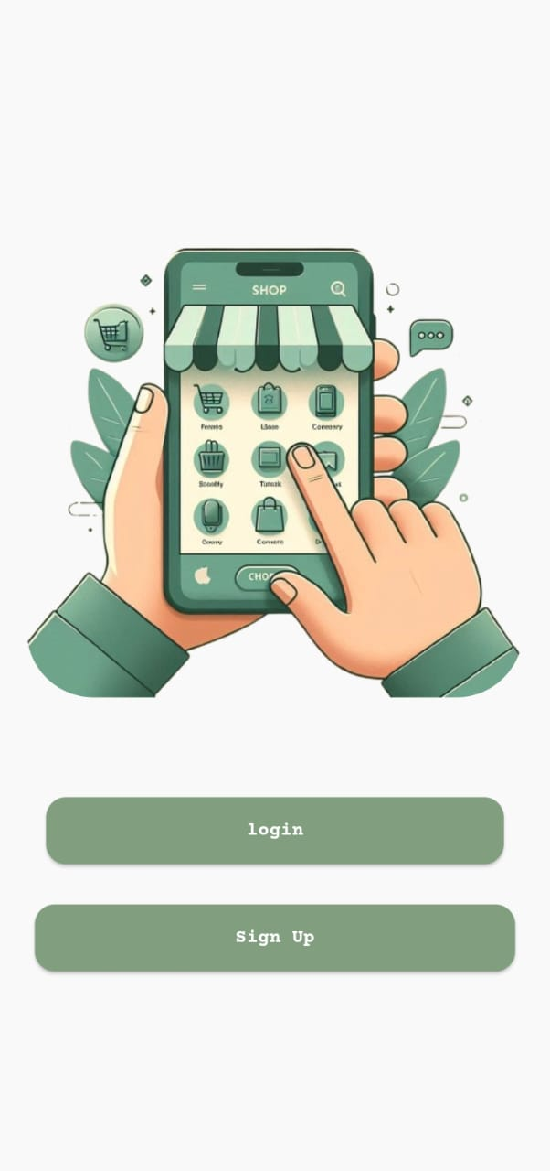

On b Authentication screens

Slide 13
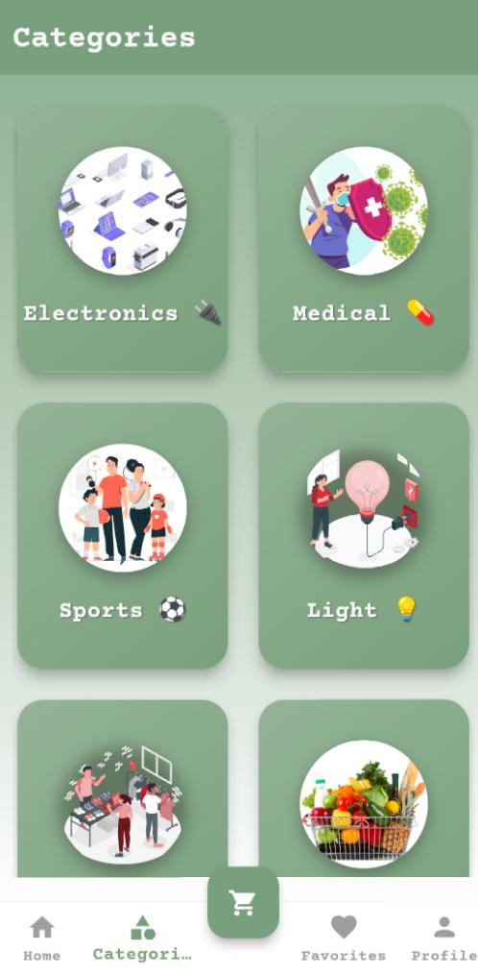
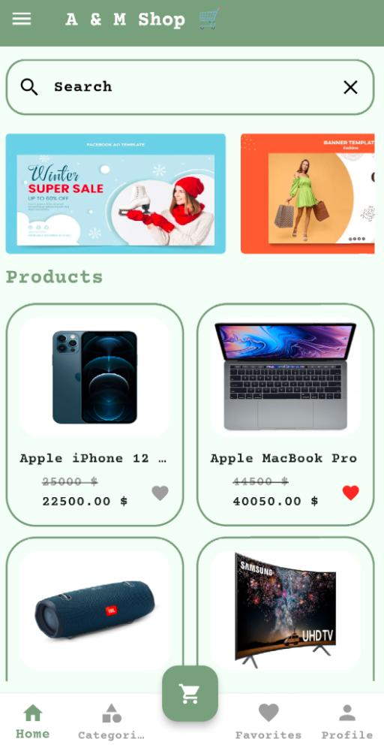
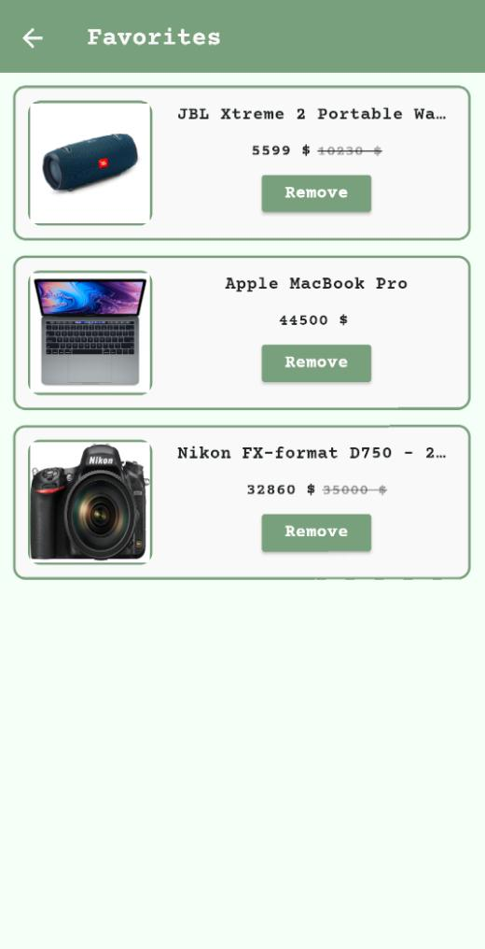
Categories screen
Home screen
Favorites screen

Slide 14
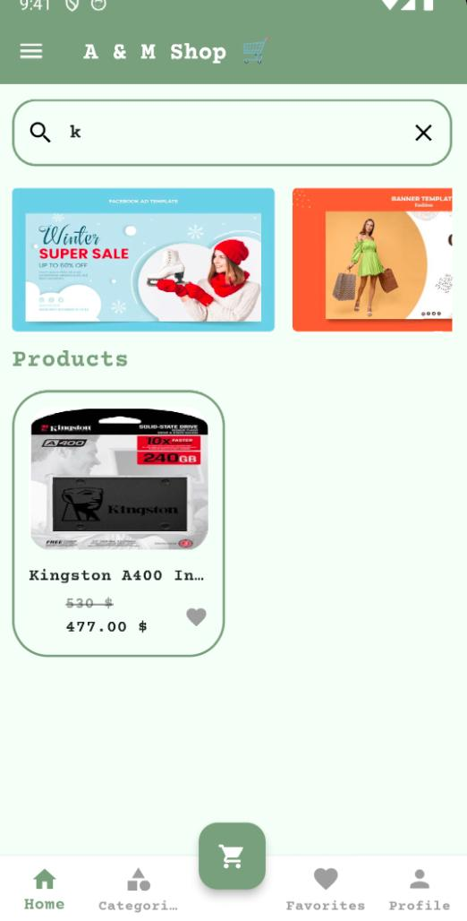
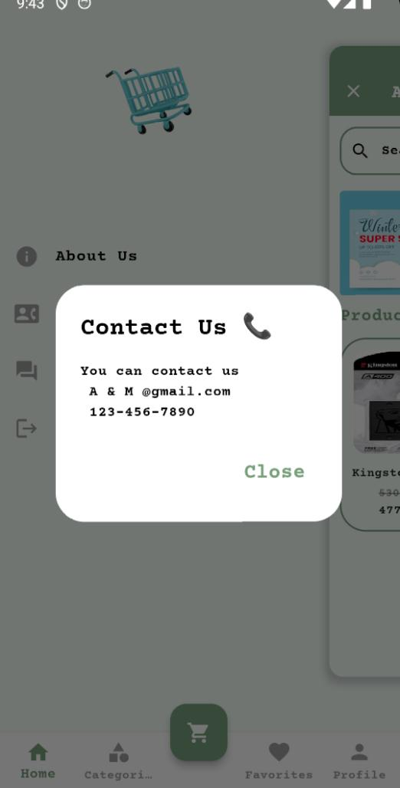
Search screen
Contact us screen

Slide 15

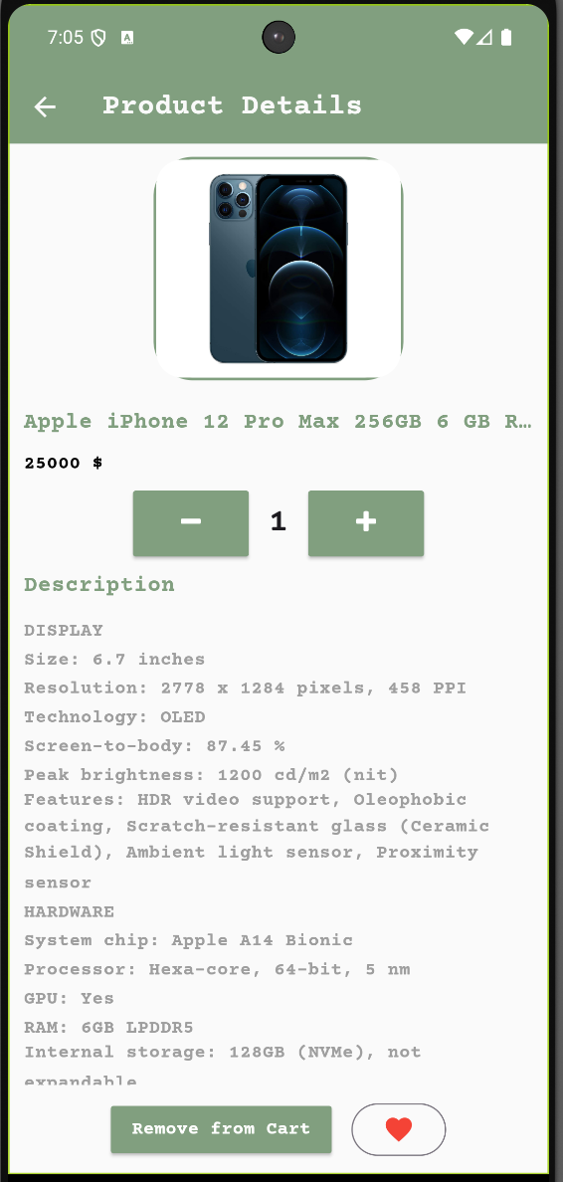
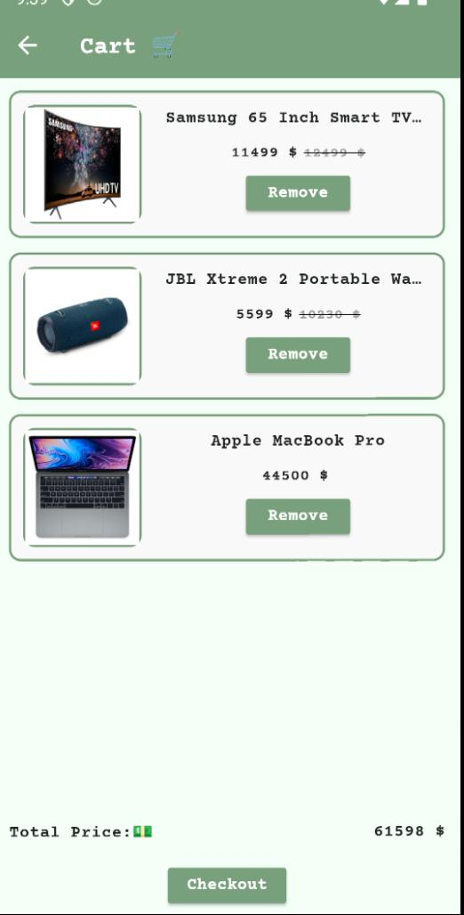
Loading Cart screen
Product Details screen
Cart screen

Slide 16


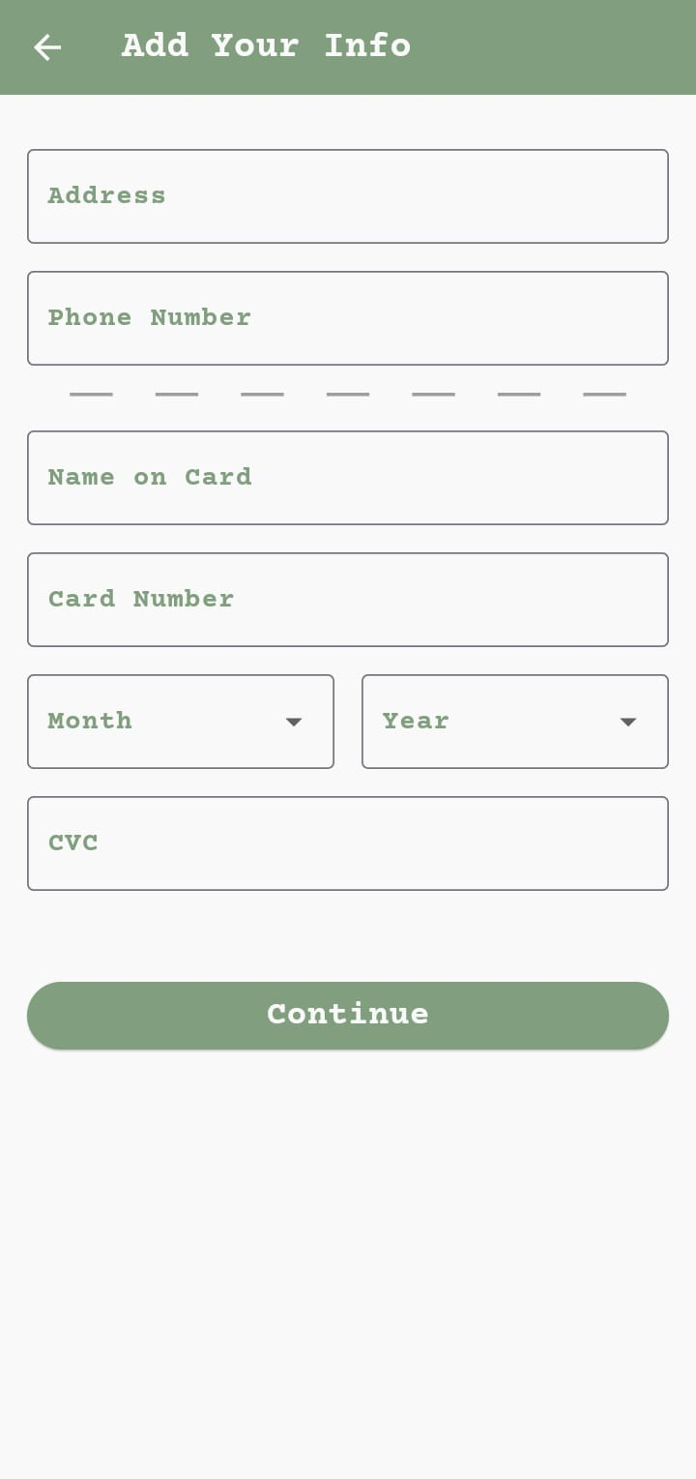
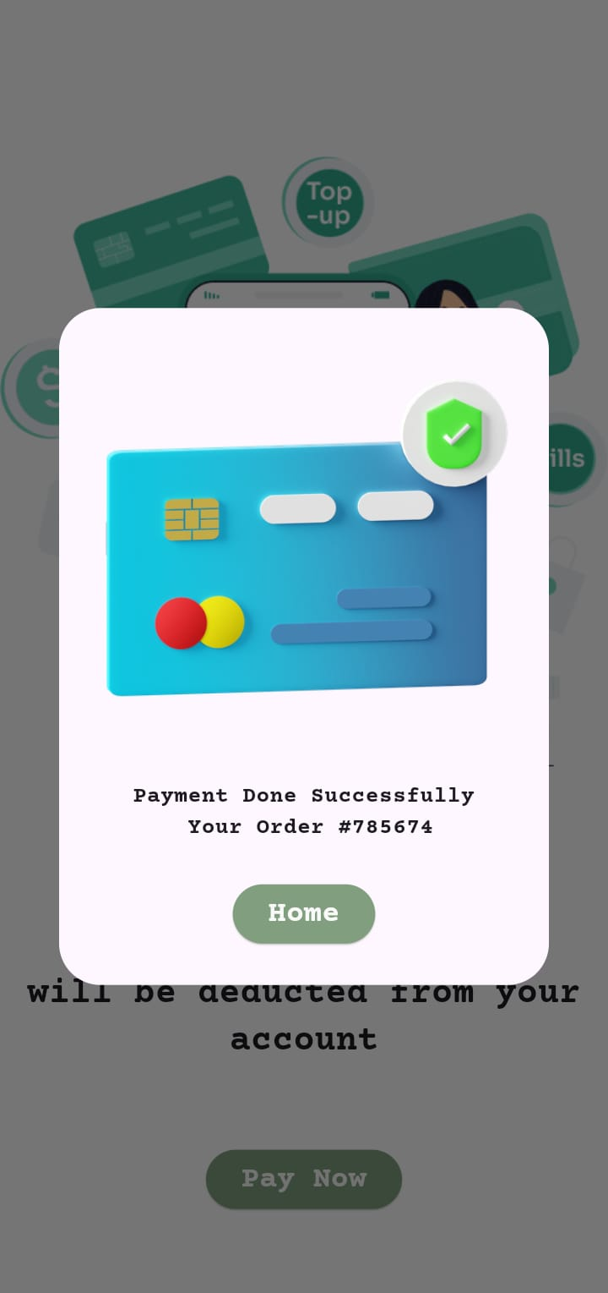
On bPayment screens

Slide 17
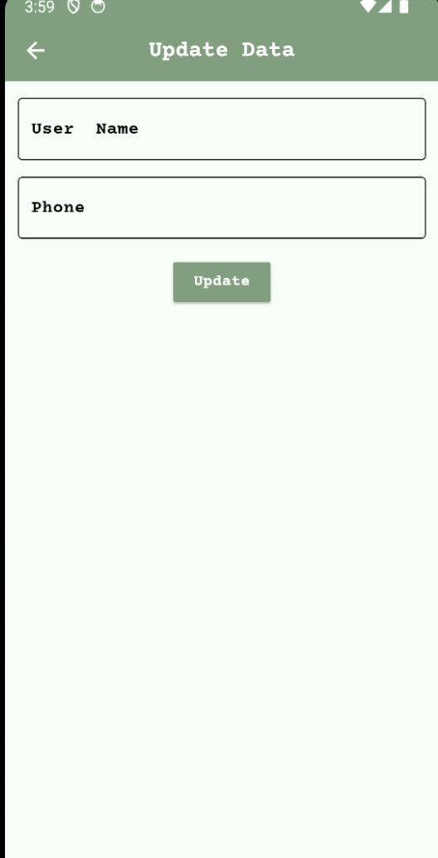
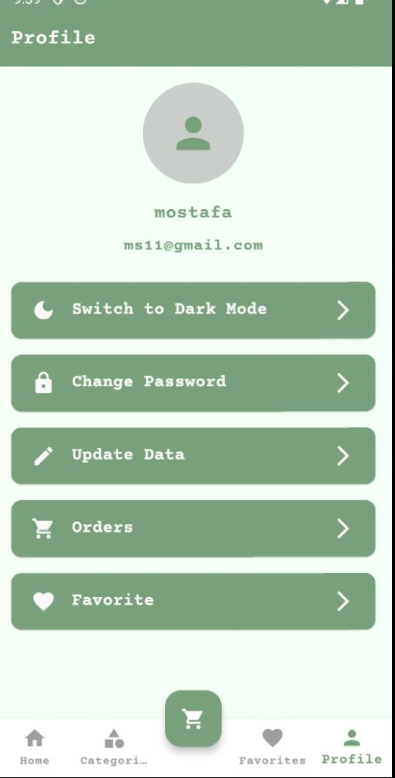
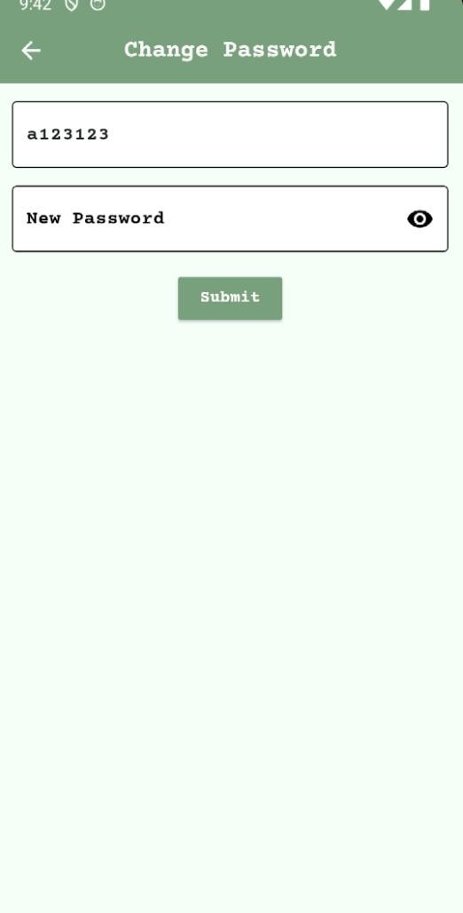
Update Data screen
Profile screen
Change Password screen

Slide 18
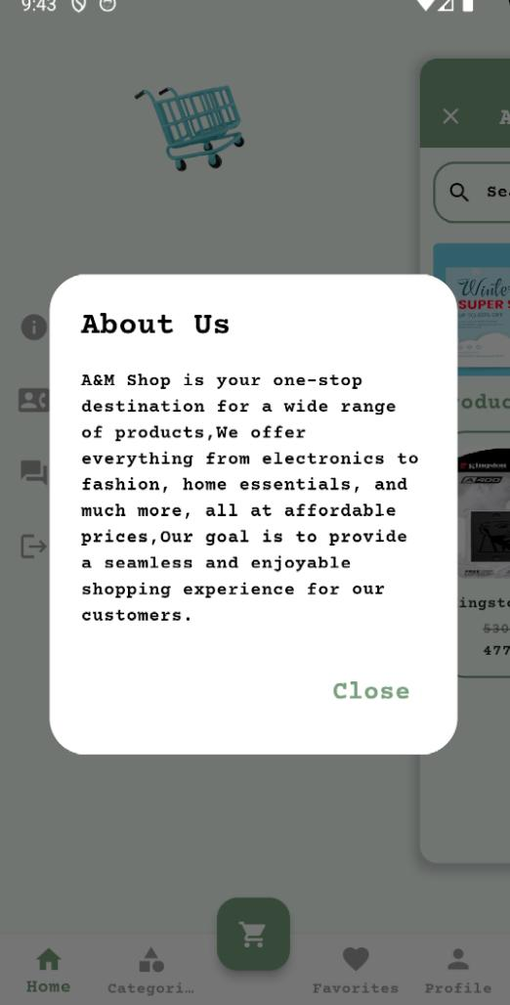
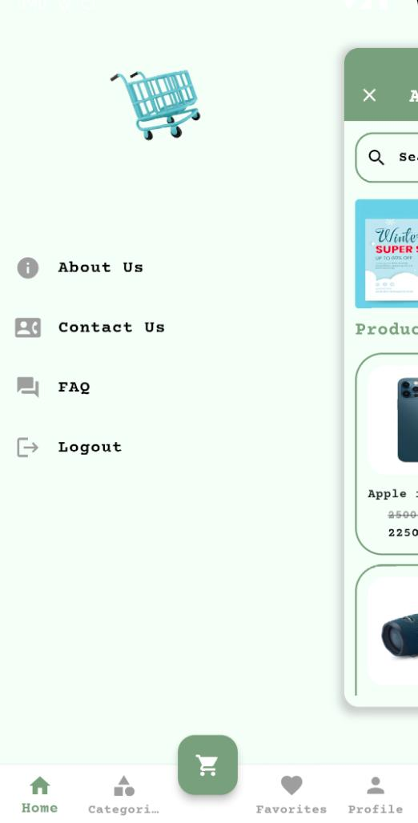
About Us screen
Setting screen
Contact Us screen

Slide 19
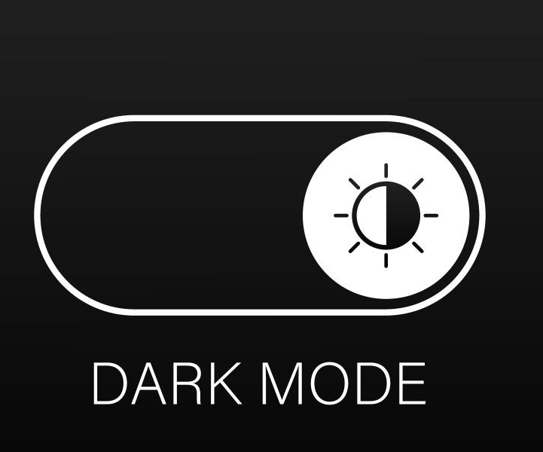
Adding Dark Mode Feature
Dark mode has become an essential feature in modern app design, offering a more comfortable and visually appealing experience for users, especially in low-light environments. By reducing the brightness and using dark backgrounds with contrasting light text, dark mode minimizes eye strain and enhances readability, making prolonged usage easier on the eyes.

Slide 20
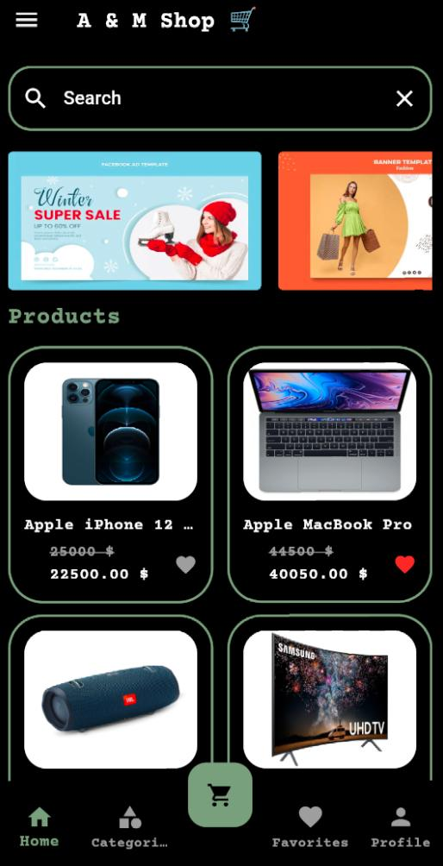
Dark Mode
Before Dark Mode

Slide 21
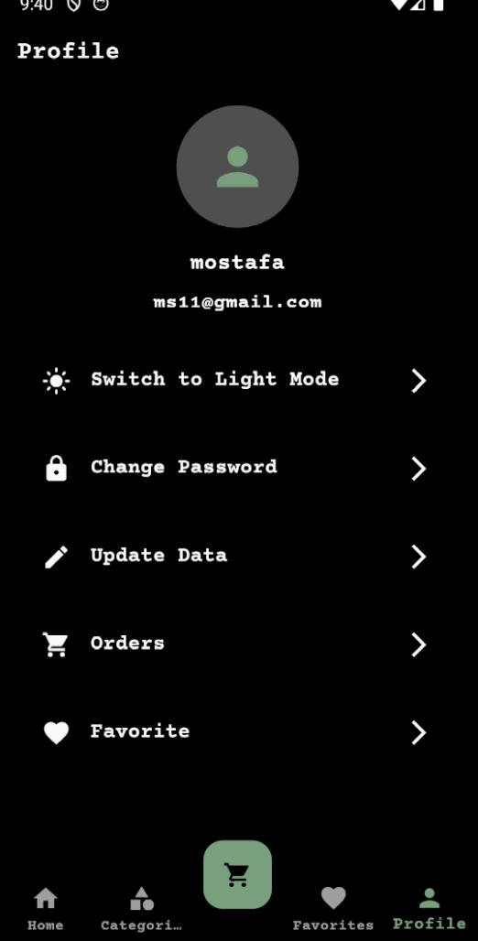
Dark Mode
Before Dark Mode

Slide 22


05
Mobile Application

Slide 23
Mobile Application
Developed using the Flutter framework, allowing for cross-platform compatibility and fast performance on both iOS and Android.
The app’s architecture ensures smooth navigation and efficient resource management.

Slide 24

06
Back - End

Slide 25





The backend manages product and user data,
We use API ,Collection
https://www.getpostman.com/collections/94db931dc5

Slide 26


07
Testing

Slide 27


Testing
The app underwent thorough testing to ensure functionality in Unit Testing for individual components

Slide 28
08
Conclusion

Slide 29
Conclusion
A&M provides a comprehensive solution to common e-commerce challenges, offering a user-friendly interface and fast performance

Slide 30


Future scope

Slide 31

Future scope
Feature Expansion: Adding features like AI-based product recommendations and multiple payment options.
Scalability: The app can be scaled to include more products, users, and advanced integrations like voice search

Slide 32
Thanks !

